Slide 1




Unified Solutions Assistant
Database Management & Database Design Project By Team 4 :-
Devashree Joshi
001009214
Mrunal Bhalerao
002124204
Krishna Dubey
001540805
Sri Sai Amulya Nittala
002194776

Slide 2
PROBLEM STATEMENT
Many students who come abroad for education purposes, face hassles while settling in a new country.
Student have to deal with setting up their houses, grocery shopping and even adjusting to a new environment.
Students are also confused about the courses and electives they should select in order to get a degree of their liking.

Slide 3

PROPOSED SOLUTION
Our Unified Solutions Assistant aims to help Northeastern University students by providing
guidance for basic necessity items as well as career path recommendations.
Settling In 101
Academic Guidance for NEU COE
NEU Student Marketplace

Slide 4

Students can compare grocery and basic necessity products across a range of parameters such as – Shop, Availability and Price
FEATURES
Students can get access to Graduated Student (Alumni) data such as GPA, Courses Selected and Current Job Profiles
Students will be able to access their very own NEU Student Marketplace – a platform to buy or sell products only amongst the Northeastern Student Community

Slide 5
Contribution : Team Member 1
ER - Diagram
Data Creation – All Users, Alumni, Current Students Tables
Data Insertion – All Tables
Stored Procedures & Packages for Data Insertion
Cursors & Functions
Project Report / Presentation
Devashree Joshi
001009214

Slide 6
Contribution : Team Member 2
ER - Diagram
Data Creation – Professor, Course Catalog, Degree Tables
PL/SQL Stored Procedures
Indexes
Triggers
Role Access & Security
Mrunal Bhalerao
002124204

Slide 7
Contribution : Team Member 3
ER - Diagram
Data Creation – Marketplace Products, Pickup Tables
Data Manipulation
Views
Reports
Exception Handling
Krishna Dubey
001540805

Slide 8
Contribution : Team Member 4
ER - Diagram
Data Creation – Product, Shop, Price Tables
Views
Reports
Role Access & Security
Testing & Query Debugging
Sri Sai Amulya Nittala
002194776

Slide 9
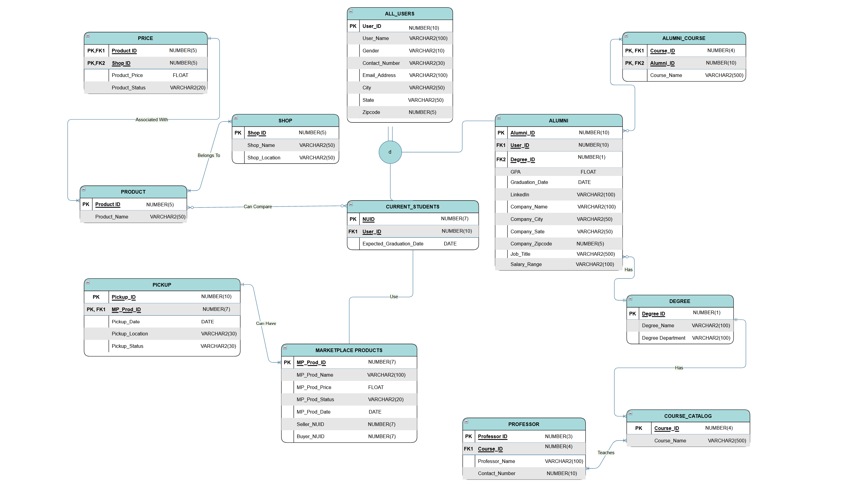
ER Diagram
Alleged reasons for the mid trial settlement

Slide 10
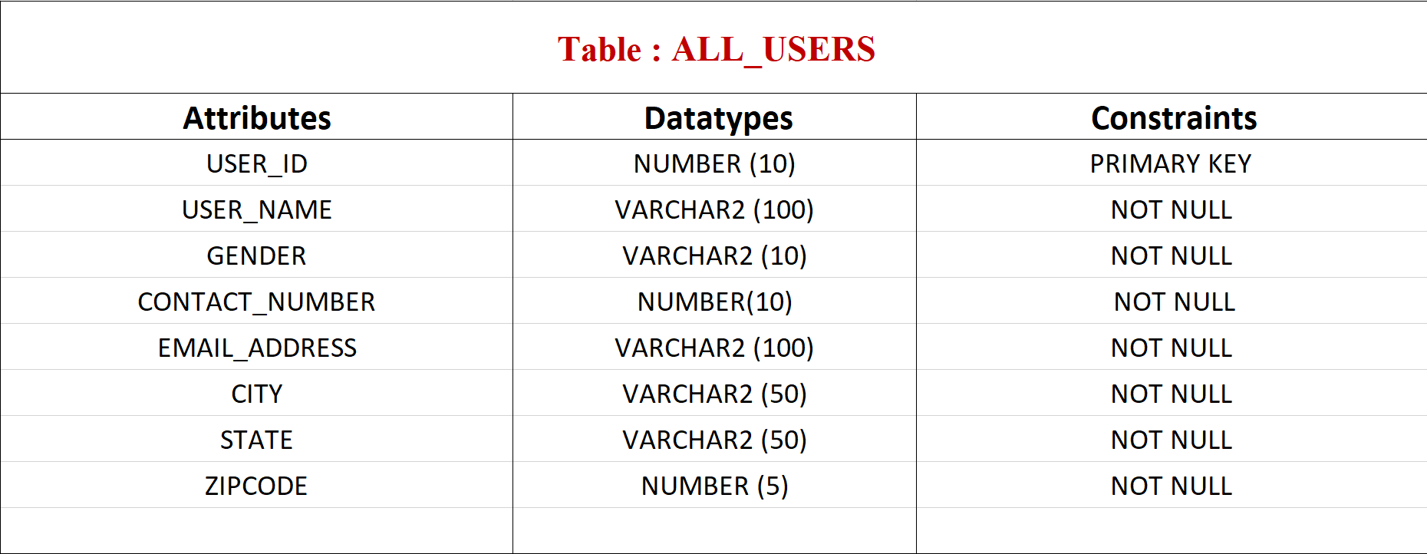
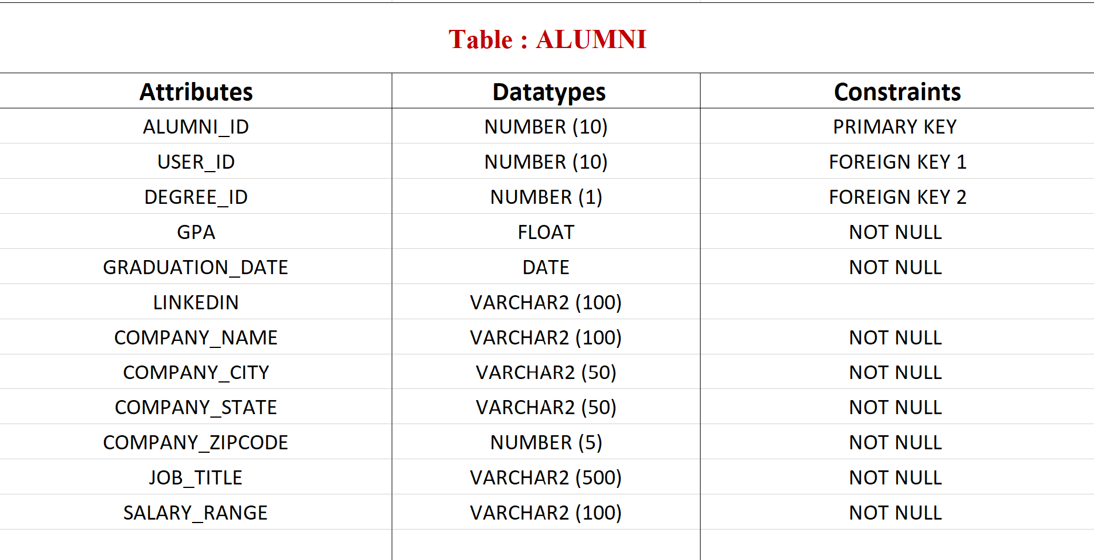
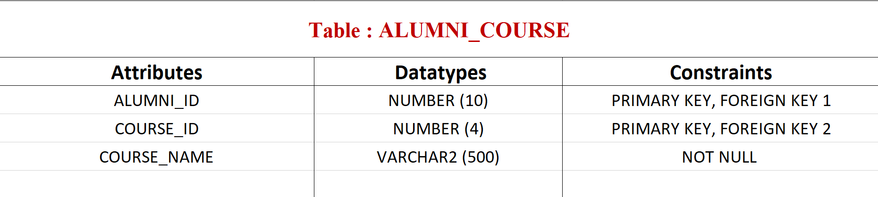
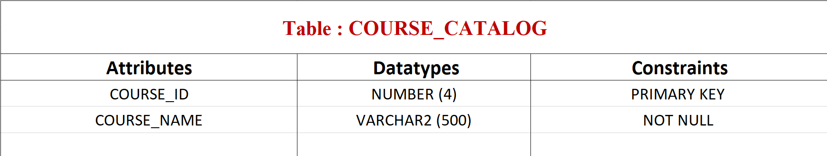
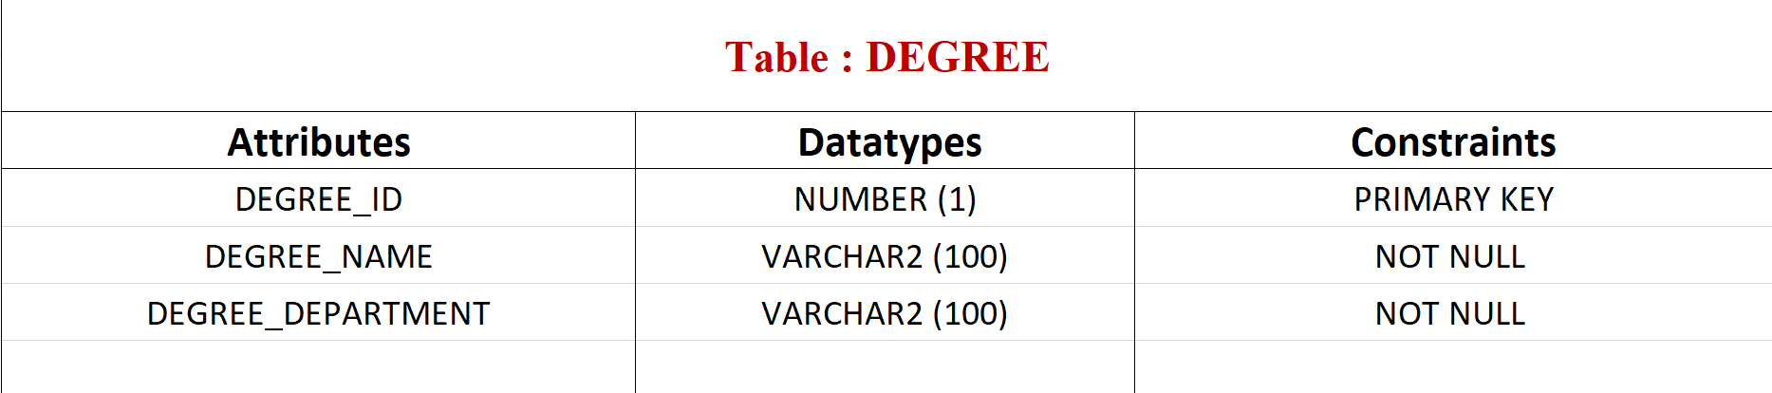
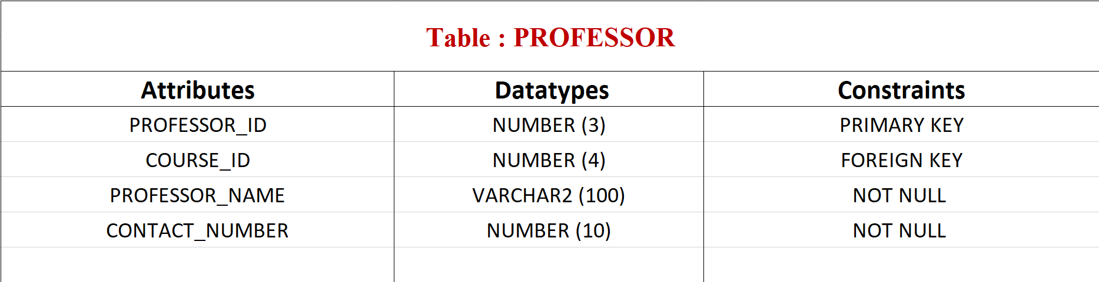
Entities & Attributes Academic guidance for College of Engineering
Alleged reasons for the mid trial settlement

Slide 11
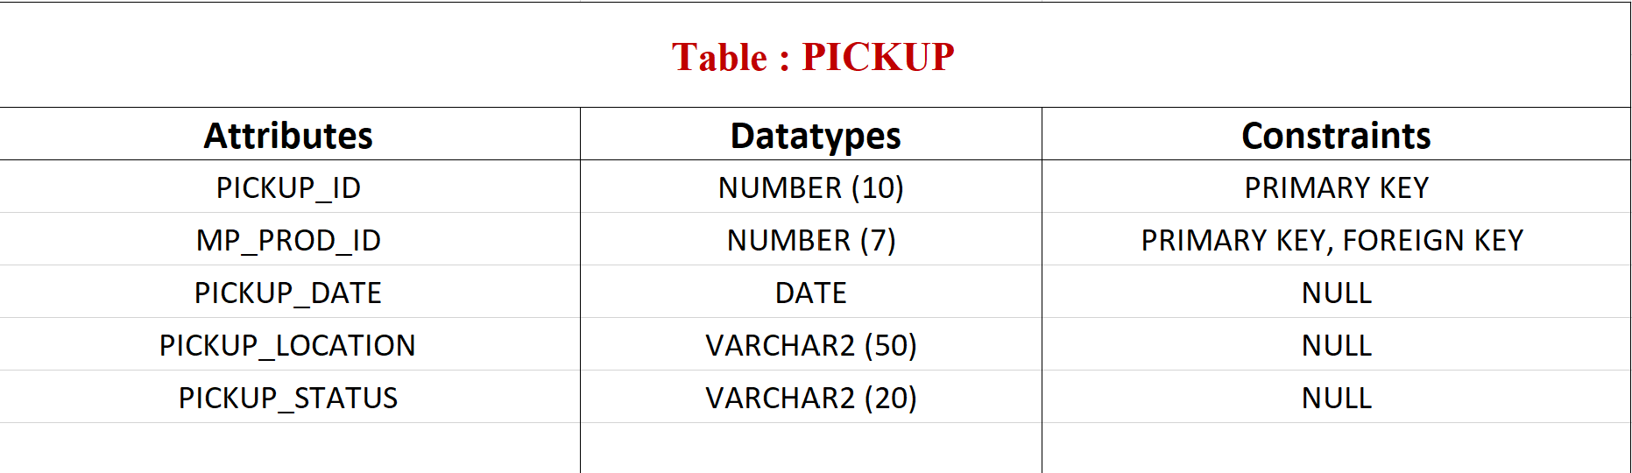
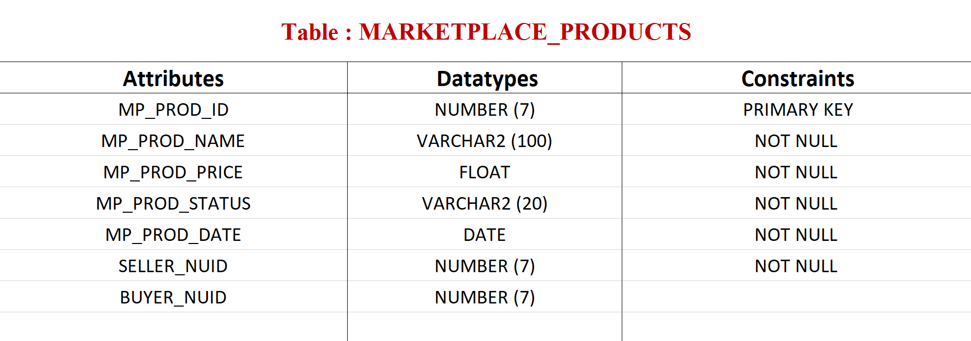
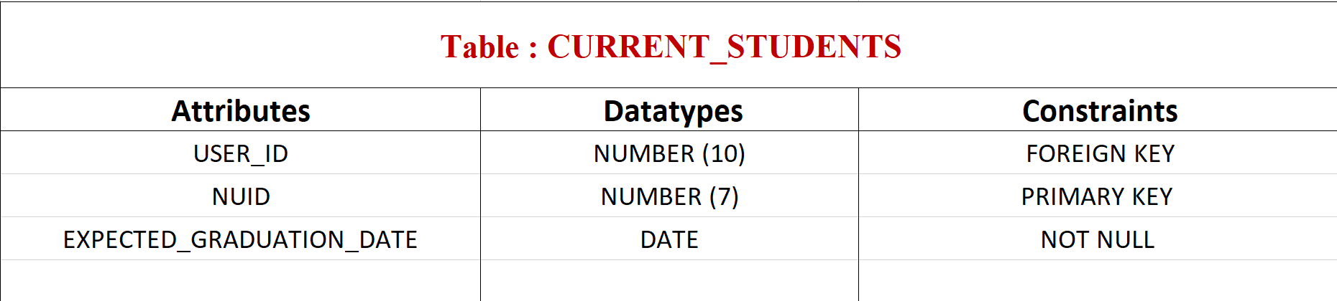
Entities & Attributes NEU Student Marketplace
Alleged reasons for the mid trial settlement

Slide 12
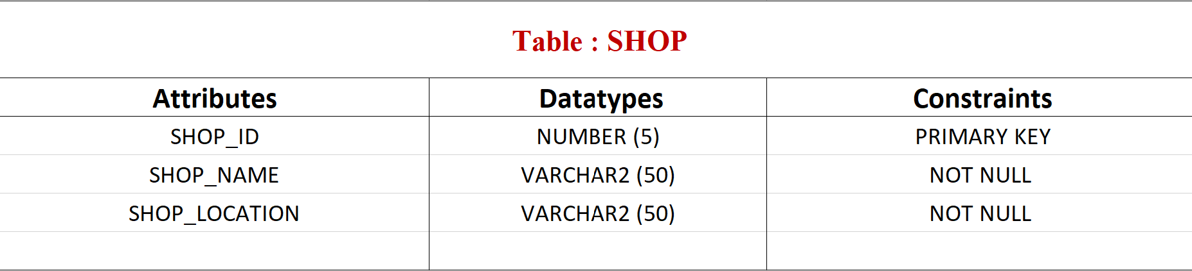
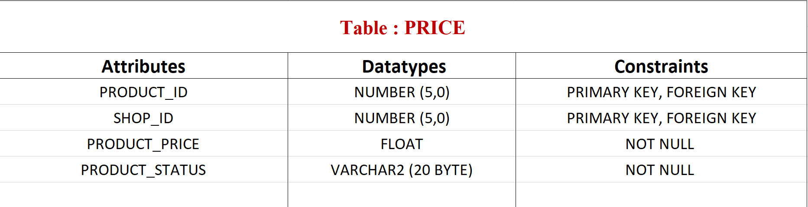
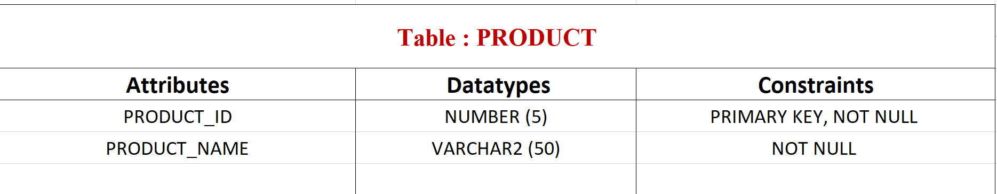
Entities & Attributes Settling In 101
Alleged reasons for the mid trial settlement

Slide 13
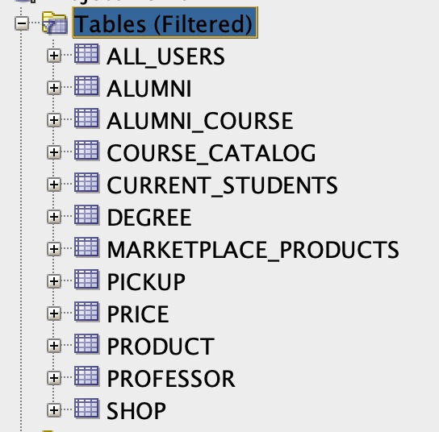
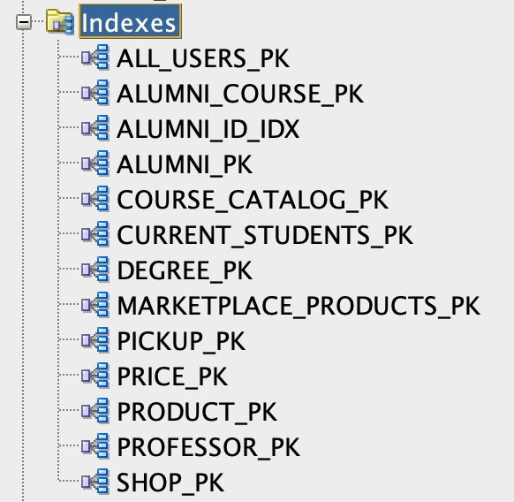
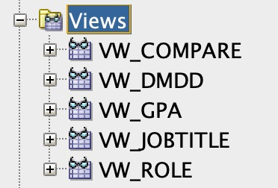
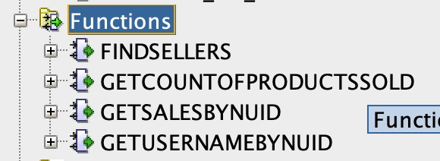

Overview of Database Objects
Alleged reasons for the mid trial settlement

Slide 14
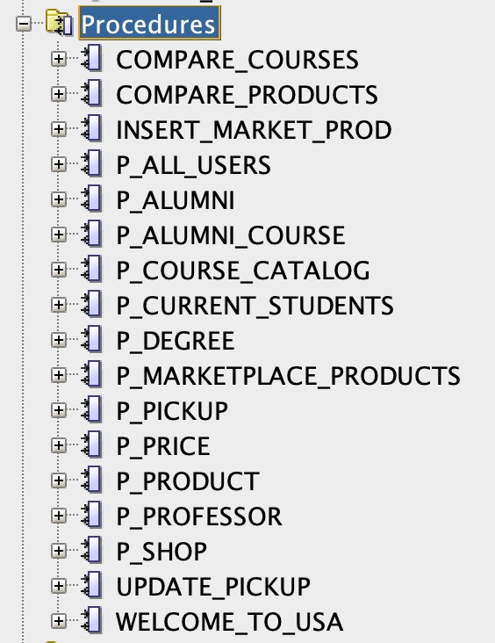

Overview of Database Objects
Alleged reasons for the mid trial settlement

Slide 15
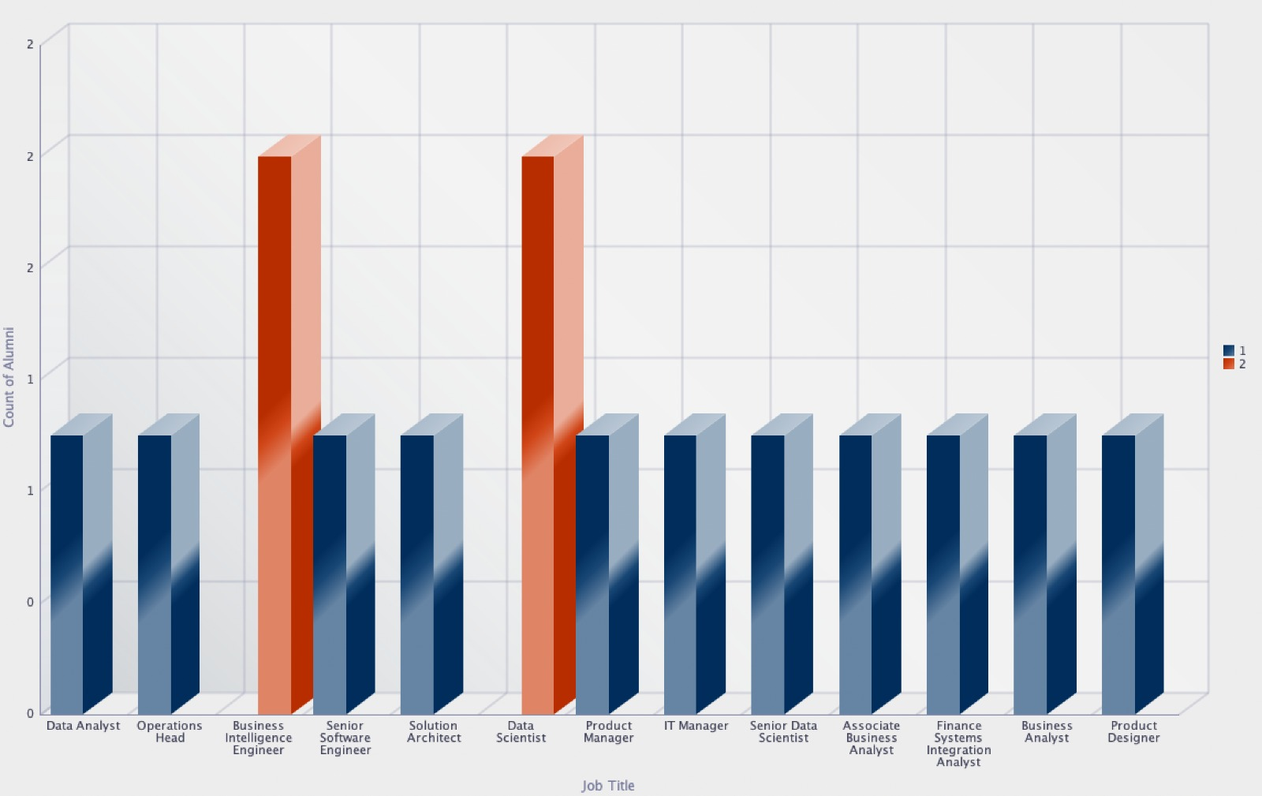
SQL Report 1 No. of alumni who took Data Management for Analytics grouped by job title
Alleged reasons for the mid trial settlement

Slide 16
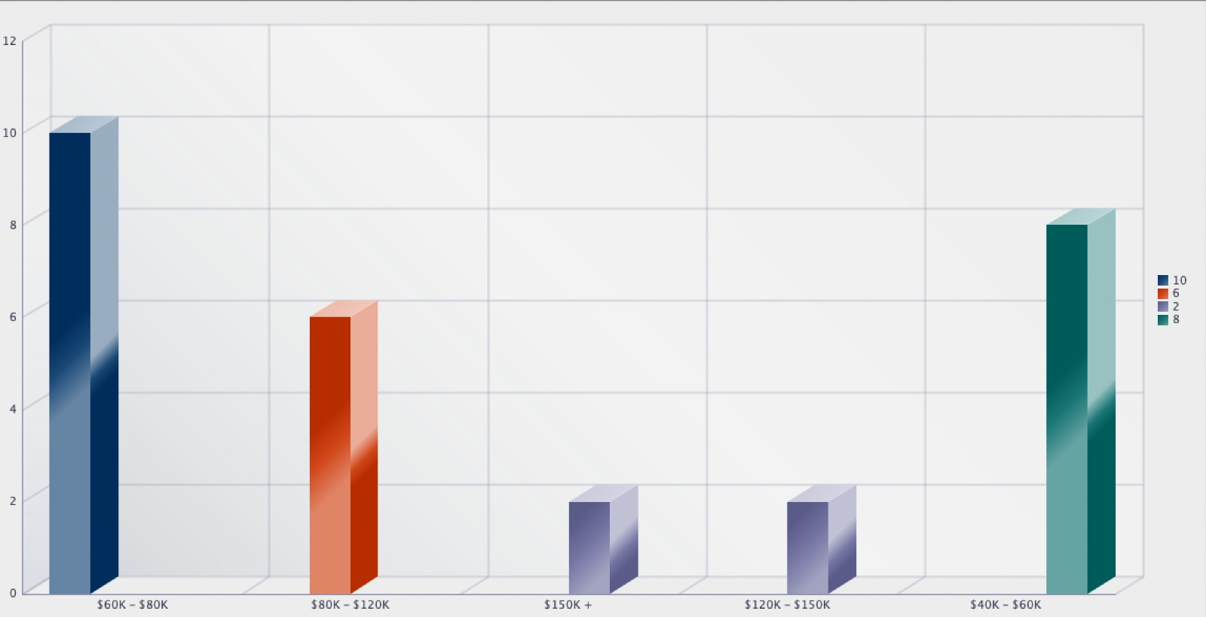
SQL Report 2 No. of alumni in MSIS grouped by salary range
Alleged reasons for the mid trial settlement

Slide 17
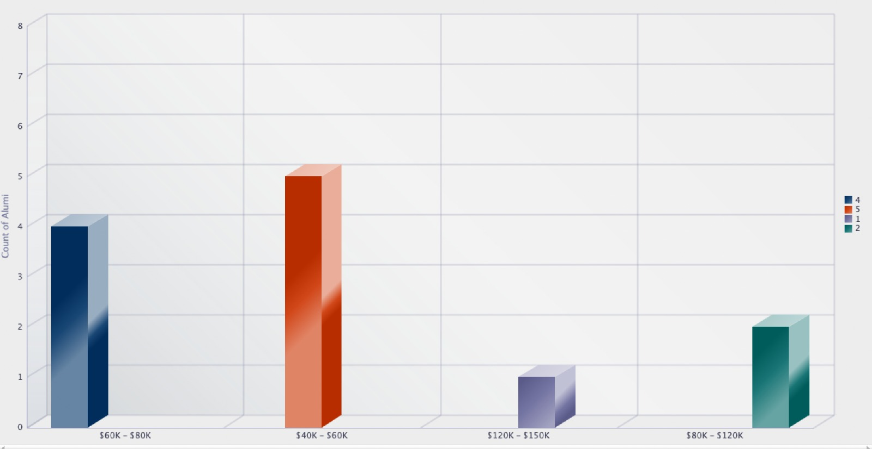
SQL Report 3 No. of alumni with GPA > 3.5 grouped by salary range
Alleged reasons for the mid trial settlement

Slide 18
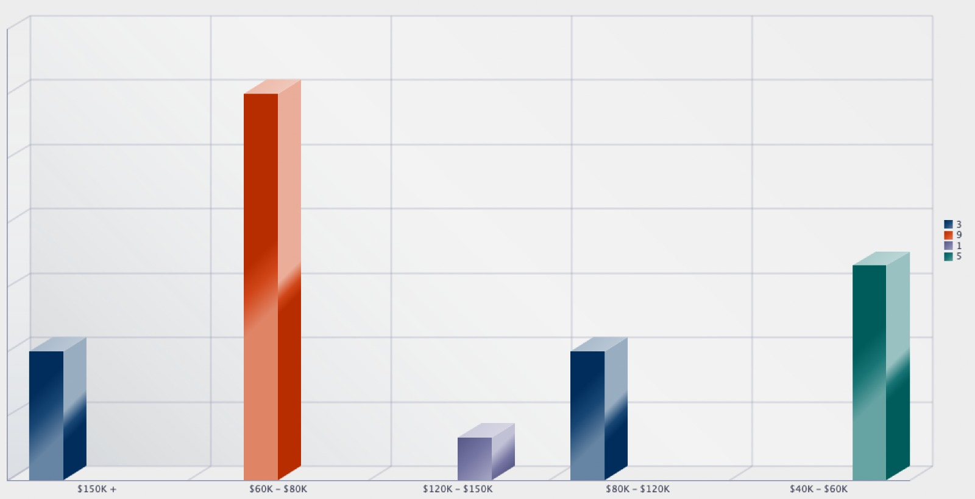
SQL Report 4 No. of alumni who took DMDD or DWBI grouped by salary range
Alleged reasons for the mid trial settlement

Slide 19
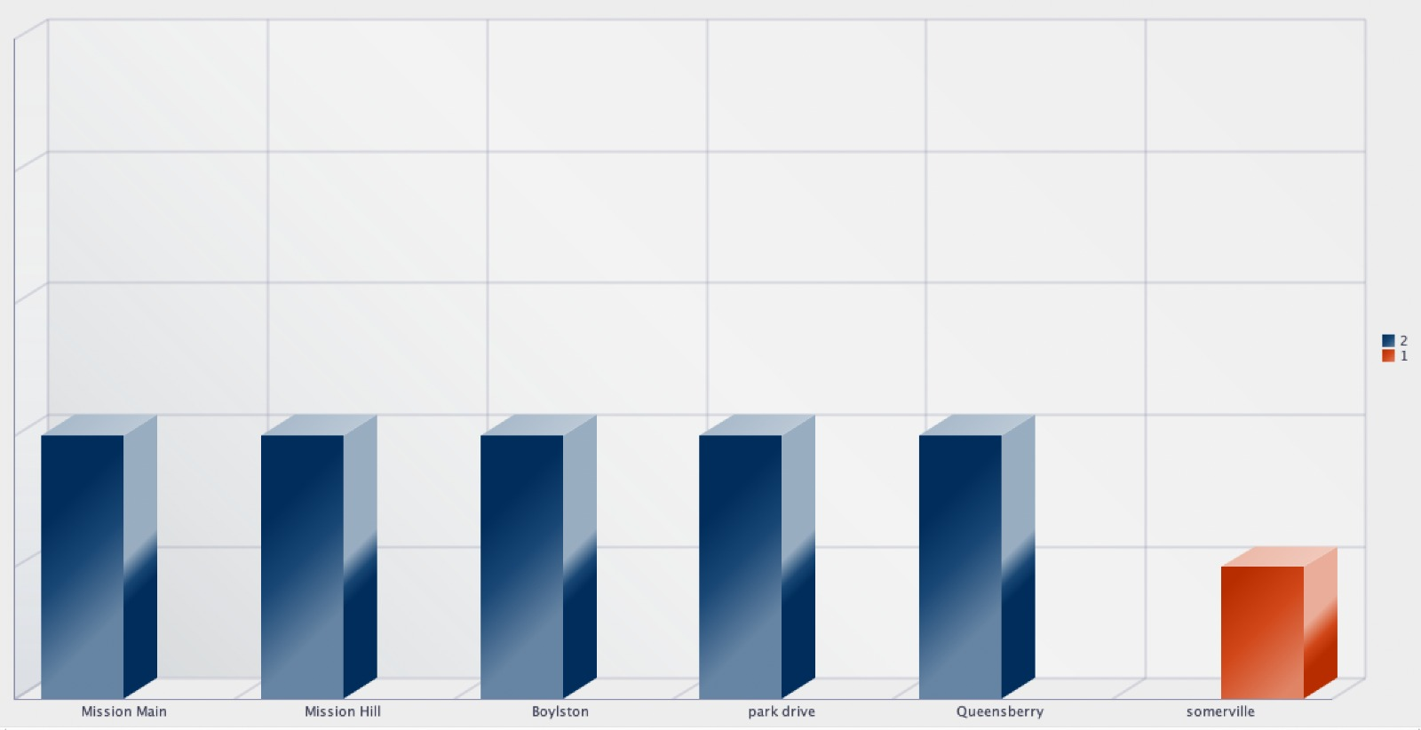
SQL Report 5 No. of pickups according to pickup location
Alleged reasons for the mid trial settlement

Slide 20
THANK YOU!

